Slide 1

Perimeter, Area, & Volume

Slide 2
Unit Goals
Find the perimeter and area of any polygon (shapes made up of flat sides).

Slide 3
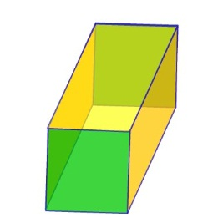
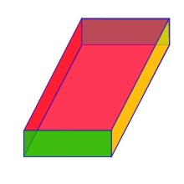
Unit Goals
Find the surface area and volume of rectangular prisms (solid figure bounded by six faces)

Slide 4
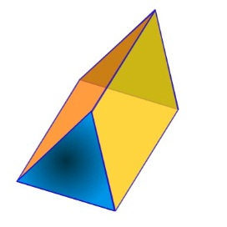
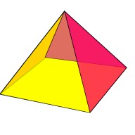
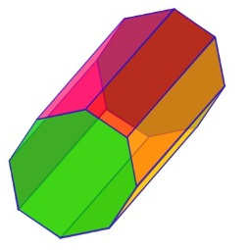
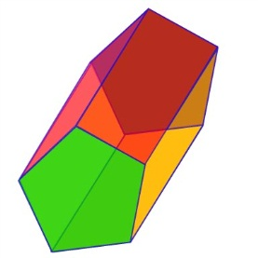
Unit Goals
Find the surface area and volume of polyhedral solids (solid in three dimensions with flat faces and straight edges).

Slide 5
Unit Essential Question
Why do we use different formulas for the same geometric shape?
Perimeter Area/Surface Area Volume

Slide 6
The Lessons
Part 1
Lesson 1 Perimeter of Polygons
Lesson 2 Perimeter of Polygons with Missing Sides
Part 2
Lesson 3 Area of Rectangles
Lesson 4 Area of Triangles
Lesson 5 Area of Parallelograms
Lesson 6 Area of Irregular Shapes
Part 3
Lesson 7 Surface Area of Rectangular Prisms and Polyhedral Solids
Part 4
Lesson 8 Volume of Rectangular Prisms and Polyhedral Solids

Slide 7

PART 1

Slide 8

SPI
Lesson 1 Perimeter of Polygons
    Goal: Decompose irregular shapes to find perimeter and area.

Slide 9
Purpose
Today you will learn how to find the distance around a figure.
While we are going over today’s lesson I want you to think about the following question.

Slide 10
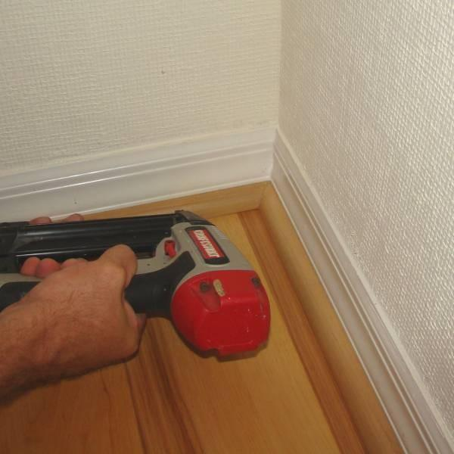
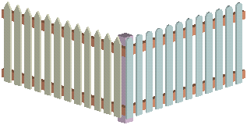
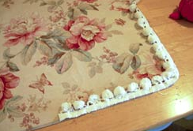
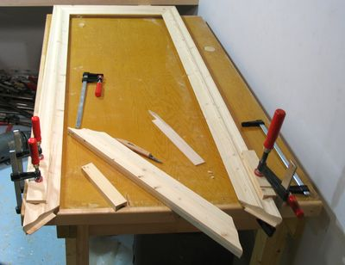
Essential Question
When might you need
to know the total distance
around an object?

Slide 11
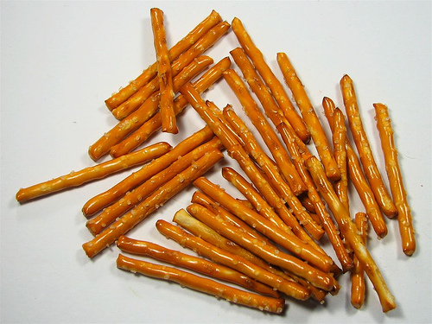



Hook
Your new puppies keep leaving the yard. You must build a fence to keep them at home. You have 12 sections of fencing. How can you arrange the fencing so that your puppies have plenty of room to roam?
Use the stick pretzels to
represent each section
of fencing.

Slide 12
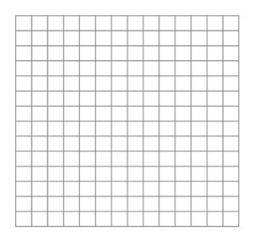
Partner Activity
Draw your fence on the grid paper.
Is there another way to build your fence with different dimensions?

Slide 13
How to Find Perimeter-
Knowledge
The distance around a shape is called the perimeter.
BrainPop Jr. (4:30 minutes)
http://www.brainpopjr.com/math/measurement/perimeter/

Slide 14
Formula –
Comprehend
Perimeter can always be computed by adding the lengths of the sides of the polygon.
Remember - Perimeter means the length around an object.
Complete Graphic Organizer.

Slide 15
Guided Practice –
Application
Let’s find the perimeter of this surface if each square is equal to one foot.
Count the number of sides.
Perimeter = 24 feet

Slide 16
Guided Practice –
Application
Try this one!
Count the number of sides to determine the perimeter of this flat object.
The perimeter is equal to 12.

Slide 17

Guided Practice –
Analyze
Now look at those same two pools. Which family has more side panels of the pool to clean?
The perimeter of Family A’s pool is 12 units long.
The perimeter of Family B’s pool is 14 units long.
Therefore, Family B has more side panels of the pool to clean.
Family A
Family B

Slide 18

Comprehend
Did it help you when the black lines appeared to help you count the number of units in the last three shapes? When figuring perimeter it is important to highlight each line segment you will be adding together, so you will not make a mistake. Here is something that will help you remember just how important it is to highlight the perimeter.
If you don’t highlight,
you won’t get it right.

Slide 19
Guided Practice –
Application
6 cm
6 cm
2 cm
2 cm
8 cm
Find the perimeter of this figure.
6 +
2 +
8 +
2 +
6 =
24 cm

Slide 20
Guided Practice –
Application
12 in.
12 in.
10 in.
Find the perimeter of this figure.
12 +
34 in.
10 +
12 =

Slide 21
Problem Solving -
Real Life Problem
Application, Analysis, Synthesis, Evaluation
You have been hired to create greeting cards. You want to make the most money by using the least amount of materials.
The Challenge:
Which card would cost the least amount to create?

Slide 22
Problem Solving -
Real Life Problem
Measure the perimeter around the front of each card and record.
Compare the measurements to determine which would require the least amount of trim.
Create the card which would cost you the least money.
Friends
Forever
Happy
Day
Congrats

Slide 23
Write Your Argument
Justify your choice.
Write to explain why you choose the specific card over the other two cards choices.
Share your conclusions with the class.
Friends
Forever
Happy
Day
Congrats

Slide 24

Closure
    The focus for this lesson was to decompose irregular shapes to find perimeter and area.

Slide 25

Reflection
Write one example of when you might use perimeter.
You will share this with a partner.

Slide 26
SPI
Lesson 2 Perimeter of Polygons
    Goal: Decompose irregular shapes to find perimeter and area.

Slide 27
Essential Question
When might you need
to know the total distance
around an object?

Slide 28

Hook
You are decorating stars by gluing beads around the perimeter for your friend’s party.
How many beads will it take to decorate one point of the star?
What is the fastest way to determine how many beads are needed to finish decorating the star after one point is decorated?

Slide 29
Hook
Compare your star with your partners. Does each point of the star have the same number of beads? Write a simple math problem to show how you could calculate the number of beads needed to outline the perimeter of your star.

Slide 30
Guided Practice
What is the perimeter of this irregular shape?
To find the perimeter, you first need to make sure you have all of the information you need.
19yd
We are missing 2 numbers, you subtract or add to find these numbers.
18yd
7yd
30yd
23 yd
37yd
Add all of the sides up
Highlight the vertical sides all of the same color to help you.
The perimeter is 134 yd
Subtract 30 and 23
The missing side is 7.
Highlight the horizontal sides all of the same color to help you.
Subtract 37 and 19
The missing side is 18.

Slide 31
Guided Practice
What is the perimeter of this irregular shape?
20in
3in
13in
7in
19in
13in
9in
20in
Highlight the sides of your shape.
Find the missing numbers for your shape
Now that you have all of sides figured out you just need to add to find the perimeter
The perimeter is…..
104 in

Slide 32
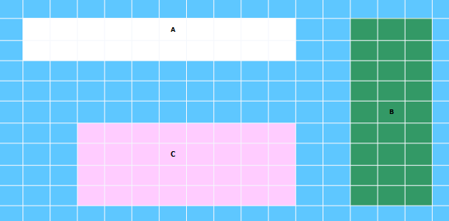
Problem Solving
Carefully examine each of the three rectangles shown below.
= 1 square unit
Each rectangle represents the backyard of a house. Which house would need to buy the most fencing material to completely enclose the yard?

Slide 33
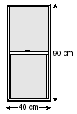
Problem Solving
A window frame in the shape of a rectangle is 90 centimeters long and 40 centimeters wide. What is the perimeter of the window frame?

Slide 34
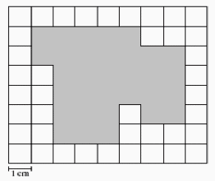
Problem Solving
= 1 square unit
Chester drew the shaded figure on the grid paper shown below. What is the perimeter, in square centimeters, of the shaded figure on Chester's grid?

Slide 35

Problem Solving
On hot summer days, much unwanted heat enters the home through the roof, walls, and glass. There are several ways to deal with this:
  Roofs and walls are best protected by using insulation and vegetation. Vegetation, such as trees and shrubs, can really help to protect the home by preventing sunlight from directly hitting it.

Slide 36
Problem Solving
You live in a rectangular shaped home. Each member of the class will be given different dimensions for your home.
You want to plant shrubs around the home to help protect the exterior walls from direct sunlight. You are to plant the shrubs 3 feet apart. Approximately how many shrubs will you need to surround the house?
Create a model of your house with its vegetation to scale.
Compare your model with your classmates.
Whose home need the most plants? Why?

Slide 37
Closure
    The focus for this lesson was to decompose irregular shapes to find perimeter and area.

Slide 38
Reflection
Write down one reason why understanding perimeter is important.
You will share this with a partner.

Slide 39

PART 2
Lesson 3 Area of Rectangles
Lesson 4 Area of Parallelograms Lesson 5 Area of Triangles
Lesson 6 Area of Irregular Shapes

Slide 40
SPI
Lesson 3 Area of Rectangles
    Goal: Decompose irregular shapes to find perimeter and area.

Slide 41
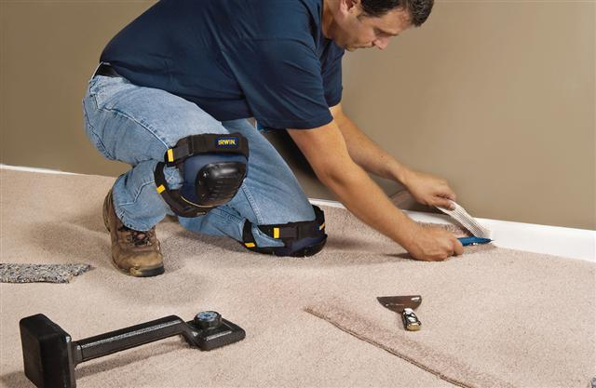
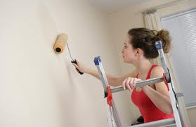
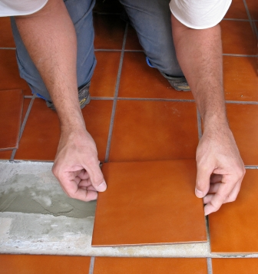
Essential Questions
How is finding area different from finding perimeter?

Slide 42
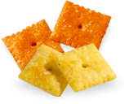
Hook
Use your Cheez-It crackers to find the area of each shape! Write the area inside each shape.

Slide 43

Width
Formula
Definition:
How wide a figure is from side to side.

Slide 44
Length
Formula
Definition:
The measure of the distance across an figure.

Slide 45
Area of a Rectangle
Formula
A=LW
Length times Width
Length
= 20 cm
width
A=20 • 12
A=240 cm²
=12 cm

Slide 46
Area of a Square
Formula
A= s²
A= side to the second power
side
A= 6²
A= 6•6
A= 36 ft²
6 feet

Slide 47
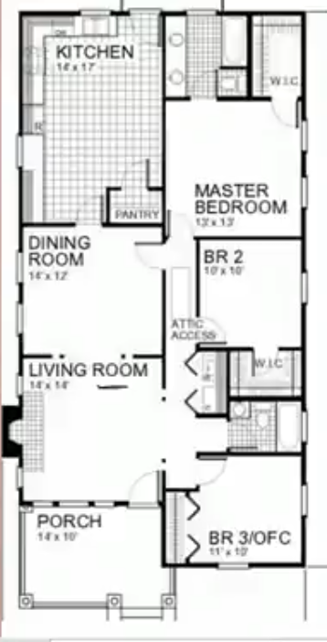
Problem Solving -
Real Life Problem
Application, Analysis, Synthesis, Evaluation
To the left is a house plan of your home. You want to carpet to your living room. Go to the Home Depot website below and choose your carpet. How much will it cost you to carpet your living room?
http://www.homedepot.com/Flooring-Carpet-Carpet-Tile/h_d1/N-5yc1vZarl0/h_d2/Navigation?langId=-1&storeId=10051&catalogId=10053&cm_mmc=SEM|THD|G|VF|FallFlooring|D23Carpet&skwcid=TC|13168|carpet%20prices||S|p|7880633317

Slide 48
Closure
    This lesson taught an essential skill needed to know how to decompose irregular shapes to find perimeter and area which you will focus on in more detail in Lesson 6.

Slide 49
Perimeter
Reflection
Work with a partner.
Create a T chart. Label the chart as shown.
List at least three ways you might use perimeter and three ways you might use area.
Area
Fencing
Border
Edging
Painting
Carpet
Tiles

Slide 50
SPI
Lesson 4 Area of Parallelograms
    Goal: Solve contextual problems that require calculating the area of triangles and parallelograms.

Slide 51
Essential Questions
How is finding area different from finding perimeter?

Slide 52
Hook
On the grid paper draw a parallelogram.
Cut the parallelogram so that you have a triangles.
Move the triangle to the opposite side of the parallelogram.
Discussion
What shape do you have now?
Has the area of the shape changed?
What conclusions can you make?

Slide 53
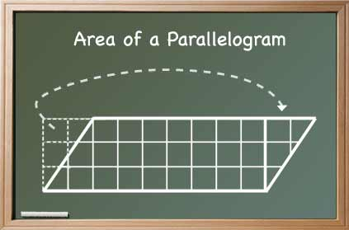
Hook
Shape Cutter
http://illuminations.nctm.org/ActivityDetail.aspx?ID=72

Slide 54
Base
Formula
Definition:
A side or face of a figure on which the figure stands.

Slide 55
Height
Formula
Definition:
The distance from the bottom to the top of a figure.

Slide 56
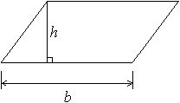
Formula
Area of Parallelograms
A = bh
A = 5 • 3
A = 15 m²
3 m
5 m

Slide 57
Practice
Area of Parallelograms
Online Area Tool
http://illuminations.nctm.org/ActivityDetail.aspx?ID=108

Slide 58
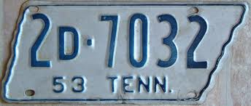
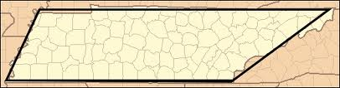
Problem Solving -
Real Life Problem
Application, Analysis, Synthesis, Evaluation
Can you name a state that is shaped like a parallelogram?
What is the area of the state of Tennessee?
Using a scaled map take measure the height and base. Use the formula to find the area.
Use the map scale to determine the area.

Slide 59
Closure
The focus for this lesson was to solve contextual problems that require calculating the area of triangles and parallelograms.

Slide 60
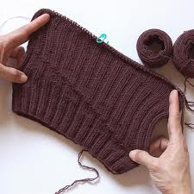
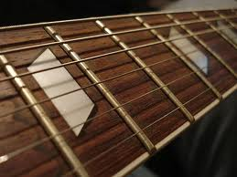
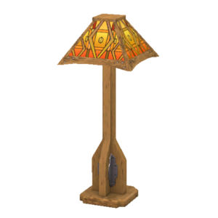
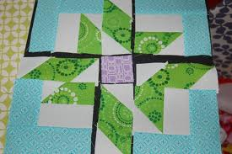
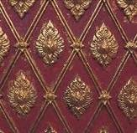
Reflection
Work with a partner.
Name three objects that have the parallelogram shape.
Tell one example when you would need to determine the area of a parallelogram.

Slide 61
SPI
Lesson 5 Area of Triangles
    Goal: Solve contextual problems that require calculating the area of triangles and parallelograms.

Slide 62
Essential Questions
How is finding area different from finding perimeter?

Slide 63
Hook
You will work with a partner. Your group will be given 3 rectangular pieces of paper. Cut each rectangular piece of paper on the diagonal like these.
Answer these questions.
Are the two halves exactly the same size?
Does the size of the rectangle effect the results?

Slide 64
Base
Formula
Definition:
A side or face of a figure on which the figure stands.

Slide 65
Height
Formula
Definition:
The distance from the bottom to the top of a figure.

Slide 66
Area of Triangle
Formula
A= ½bh
A= ½ • b • h
Height
A= ½ • 8 • 9.5
A= 0.5 • 8 • 9.5
A= 38 km²
= 9.5 km
Base (bottom)
8 km

Slide 67
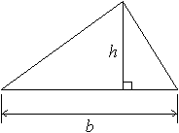
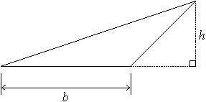
Formula
Area of a Triangle
A = ½ • 33 • 54
A = 0.5 • 33 • 54
A = 891 mm²
33 mm
54 mm

Slide 68
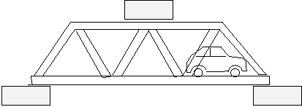
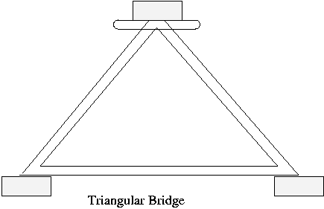
Problem Solving -
Real Life Problem
Application, Analysis, Synthesis, Evaluation
Design a bridge with popsicle sticks. Measure the area of your bridge.

Slide 69

Closure
The focus for this lesson was to learn how to solve contextual problems that require calculating the area of triangles and parallelograms.

Slide 70

Reflection
Tell a partner one thing you have learned in this lesson.
Tell one thing you felt was confusing.

Slide 71
SPI
Lesson 6 Area of Irregular Shapes
    Goal: Decompose irregular shapes to find perimeter and area.

Slide 72
Essential Questions
How is finding area different from finding perimeter?

Slide 73
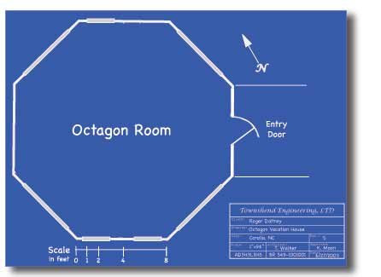
Hook
Suppose you were tiling the floor of the octagon room.
How would you go about figuring how many tiles you would need to buy?
Could you cut the room up into shapes you know?

Slide 74
Hook
Would you be able to figure the area of each of the shapes now?
Square?
Rectangles?
Triangles?

Slide 75
Guided Practice
Let’s do these problems together.
Two neighbors build swimming pools. This is what the pools look like.
Which family has the pool with the bigger swimming area?
Family A
Family B

Slide 76
Guided Practice
The area of Family A’s pool is?
8 square units.
The area of Family B’s pool is?
7 square units
Therefore, Family A has the pool with
the bigger swimming area.
Family A
Family B

Slide 77

Guided Practice
4cm
Total area = 40 + 32 = 72 cm²
2cm
To find the area of this shape we have to split it up into two rectangles.
4cm
Area =
4 x 10
10cm
Area =
4 x 8
8cm
40cm²
32cm²
8cm
A shape that is made from other shapes is known as a composite shape.

Slide 78

Find the area and perimeter of each of these shapes? Your teacher will give you copy of the worksheet.
5cm
2cm
4cm
9cm
5cm
2cm
4cm
2cm
11cm
5cm
5cm
4cm
3cm
4cm
3cm
3cm
4cm
6cm
7cm
7cm
6cm
11cm

Slide 79
Guided Practice
5cm
2cm
Area =
5 x 9
Area =
4 x 5
4cm
9cm
5cm
45cm²
20cm²
4cm
2cm
5cm
Total area = 45 + 20 = 65 cm²
Perimeter = 36 cm

Slide 80
Guided Practice
Total area = 10 + 36 = 46 cm²
Perimeter = 34 cm
2cm
11cm
5cm
Area =
2 x 5
4cm
10cm²
Area =
6 x 6
6cm
36cm²
6cm

Slide 81
Guided Practice
Total area = 28 + 16 + 21 = 65 cm²
Perimeter = 42 cm
There is another way of doing this question.
Area =
4 x 7
Area =
4 x 4
28cm²
16cm²
4cm
3cm
3cm
3cm
Area =
3 x 7
4cm
7cm
7cm
21cm²
11cm

Slide 82
Guided Practice
Total area = 77 – 12 = 65 cm²
Perimeter = 42 cm
Area =
3 x 4
12cm²
4cm
3cm
3cm
3cm
4cm
7cm
7cm
Area =
7 x 11
77cm²
11cm

Slide 83
What is the area of this irregular shape?
To find the area of an irregular shape you need to split it up into shapes you already know.
I see 2 rectangles, so I’m going to split my shape into 2 rectangles.
19yd
18yd
7yd
133
30yd
23yd
851
To get the total area you just need to add those amounts together
37yd
Find the area of each rectangle now
To find the area of the top rectangle you multiply 7 and 19 and get….
984 sq. yd
To find the area of the bottom rectangle you multiply 23 and 37 and get….

Slide 84
Guided Practice
2m
7m
2m
4m
12m

Slide 85
Guided Practice
11cm
4cm
6cm
10cm
4cm
7cm

Slide 86
Guided Practice
20cm
3cm
16cm
3cm
15cm
15cm

Slide 87
Guided Practice
Example
Work out the area shaded in each of the following diagrams
(i)
6 cm
4 cm
2 cm
8 cm

Slide 88
Guided Practice
15cm
14cm
17cm
18cm

Slide 89
Guided Practice
9m
7m
5m
5m
5m
34m

Slide 90
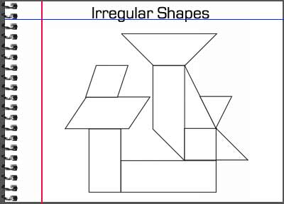
Problem Solving -
Real Life Problem
Application, Analysis, Synthesis, Evaluation
Cut out different geometric shapes (triangle, square, rectangle, parallelogram) and glue on a separate piece of paper.
Design your own picture using the geometric shapes. Glue them on a sheet of paper.
Calculate the area of your design by calculating the area of each individual piece and summing to find total area.

Slide 91
Closure
    The focus for this lesson was to learn how to decompose irregular shapes to find perimeter and area.

Slide 92

Reflection
Ticket for leaving the room.
What went well in this lesson? Why?
What problems did I experience? Why?

Slide 93
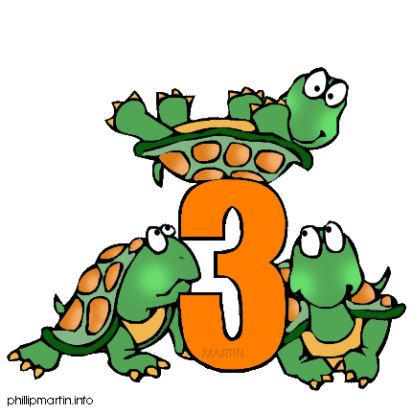
PART 3
Lesson 7 Surface Area of Rectangular Prisms and Polyhedral Solids

Slide 94
SPI
Lesson 7 Surface Area of Rectangular Prisms and Polyhedral Solids
  Goal: Solve problems involving surface area and volume of rectangular prisms and polyhedral solids.

Slide 95
Essential Question
How is surface area used

Slide 96

Hook
You will work with one partner.
You will be given several sheets of grid paper and a set of the other materials.
Use the one inch square grid paper to cover the boxes.
Do not let the squares overlap.
Be certain to cover all exposed surfaces (like gift wrapping the box).
Find the area of each side by counting the number of squares on each side.
Record this information.
What is the total surface area of your box? (Add the areas of the sides together.)
Is there a shortcut for doing this?

Slide 97
Find the surface area of this rectangular prism.
6 cm.
h
4 cm.
w
10 cm.
l
Step One- Label the length, width and height.
Step Two- Insert the measurements into the surface area formula.
SA = 2 lw + 2 lh + 2 wh
SA = 2(10)(4) + 2(10)(6) + 2(4)(6)
Step Three- Multiply
SA = 80 + 120 + 48
Step Four- Add
SA = 248 cm.²

Slide 98
Find the surface area of this rectangular prism.
2 cm.
h
3 cm.
w
15 cm.
l
Label the length, width and height.
SA = 2 lw + 2 lh + 2 wh
SA = 2(15)(3) + 2(15)(2) + 2(3)(2)
SA = 90 + 60+ 12
SA = 162 cm.²

Slide 99
Find the surface area of this rectangular prism.
5 cm.
h
4 cm.
w
l
7 cm.
Label the length, width and height.
SA = 2 lw + 2 lh + 2 wh
SA = 2(7)(4) + 2(7)(5) + 2(4)(5)
SA =56 + 70+ 40
SA = 166 cm.²

Slide 100
Find the surface area of this rectangular prism.
8 cm.
h
6 cm.
w
l
12 cm.
Label the length, width and height.
SA = 2 lw + 2 lh + 2 wh
SA = 2(12)(6) + 2(12)(8) + 2(6)(8)
SA =144 + 192+ 96
SA = 432 cm.²

Slide 101

Problem Solving -
Real Life Problem
Application, Analysis, Synthesis, Evaluation
You need to paint your house.
The Paint Shop has paint on sale for $25.00 a gallon,
but you must buy at least 10 gallons.
Painters’ Warehouse has paint on
sale of $30.00 a gallon.
Estimate the amount of paint you will need by
finding the surface area of your home.
First determine the square footage of your house. Remember to subtract 20 square feet for each door and 15 square feet for each average-sized window.
In general, you can expect 1 gallon of paint to cover about 350 square feet.
How many square feet is your home?
How many gallons of paint will you need to purchase?
From which store will you purchase your paint and why?

Slide 102
Closure
  The focus for this lesson was to learn how to solve problems involving surface area and volume of rectangular prisms and polyhedral solids.

Slide 103
Reflection
Carousel Activity
Rotate around the classroom in a small group.
Stop at each station (Perimeter, Area, and Surface Area) for three minutes.
While at each station, write down everything you can think of on the topic.
The information will be shared at the end of the activity.
Perimeter
Area
Surface Area

Slide 104

PART 4
Lesson 8 Volume of Rectangular Prisms and Polyhedral Solids

Slide 105
SPI
Lesson 5 Volume of Rectangular Prisms and Polyhedral Solids
  Goal: Solve problems involving surface area and volume of rectangular prisms and polyhedral solids.

Slide 106
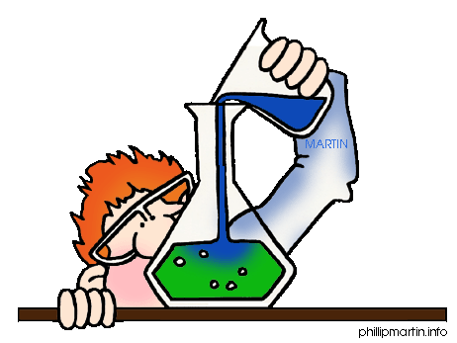
Essential Questions
For what purpose do you calculate volume?

Slide 107
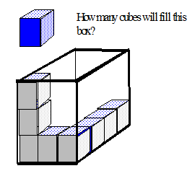
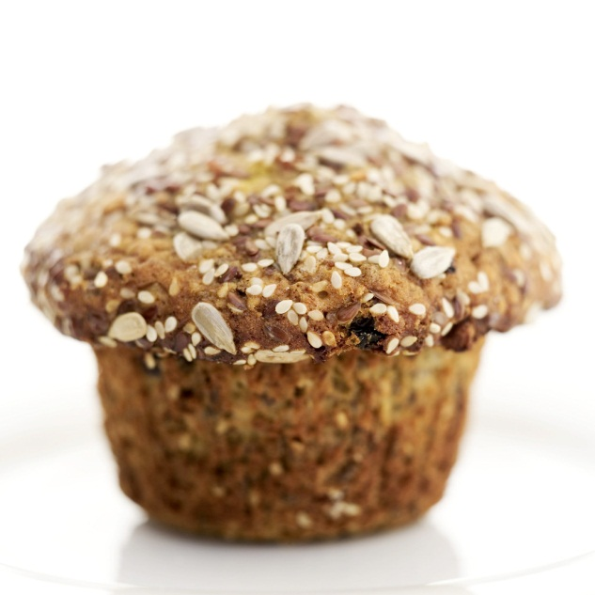
Hook
Gomer delivers muffins for the Muffin-O-Matic muffin company. Each muffin is packed in its own little box. An individual muffin box has the shape of a cube, measuring 3 inches on each side. Gomer packs the individual muffin boxes into a larger box. The larger box measures 9 inches wide, 9 inches tall, and 12 inches deep. How many of the individual muffin boxes can fit into the larger box?

Slide 108
Volume is the space that a figure occupies. It is measured in cubic units.
We can begin by stacking the cubic units in the bottom of the prism
3units
This prism holds 9 cubic units in the bottom layer.
The volume of the given cube can be found by determining how many cubic units will fit inside the cube.
We can continue to stack these layers until the prism is full.
3units
3units
This prism holds 3 layers of 9 cubic units for a total of 27 cubic units
1 cubic unit
1unit
V = 27 cubic units
1unit
1unit

Slide 109
Another way to find the volume of the prism is to use the formula
V = lwh
where V is volume, l is length, w is width, and h is height
3units
h
3units
w
3units
l
V = lwh
V = (3)(3)(3)
V = 27 cubic units
This formula works very well for rectangular prisms

Slide 110
Another way to find the volume of the prism is to use the formula
V = Bh
where V is volume, B is the base area, and h is height
3units
h
3units
w
3units
l
V = Bh
V = (9)(3)
V = 27 cubic units
Base Area
B = lw
B = (3)(3)
B = 9 square units
This formula works very well for non-rectangular prisms

Slide 111
Find the volume of this rectangular prism.
OR
Since this is a rectangular prism we can use
V = lwh
we have:
V = (5)(4)(7)
V = 140 in³
We could use
V = Bh
The base is a rectangle
B = lw
B = (5)(4)
B = 20 in²
now we use V = Bh
V = (20)(7)
V = 140 in³
7 in
4 in
5 in
In this case it’s much easier to use V = lwh

Slide 112
Find the volume of this triangular prism
Since this is a triangular prism we must use
V = Bh
since the base is a triangle we must find the area of the triangle first using:
B = (1/2)bh
(where b & h are perpendicular)
B = (1/2)(3)(4)
B = (1/2)(12)
B = 6 cm²
BASE AREA
B = 6 cm²
5 cm
Now we use
V = Bh
where h is the distance between the bases.
V = (6 cm²)(9 cm)
V = 54 cm³
4 cm
9 cm
3 cm

Slide 113
Closure
  The focus for this lesson was to learn how to solve problems involving surface area and volume of rectangular prisms and polyhedral solids.

Slide 114
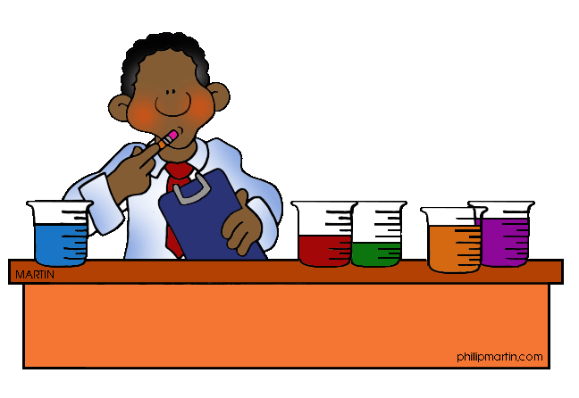
Reflection
Exit Ticket Question
What was confusing in today’s lesson?

Slide 115


